Slide 1
Solving Inequalities Using the Graphical Method

Slide 2


We have learnt how to solve f(x) = k by drawing the graph of y = k on the graph of y = f(x), can we use the same method to solve inequalities?
Yes, if the graph of y = f(x) is given,
we can solve the inequalities
f(x) > k and f(x) < k, where k is a constant,
by using the graphical method.

Slide 3
The procedure is as follows:
Step 1
y
y = f(x)
Write down the corresponding
simultaneous equations .
y = k
0
x
Step 2
Draw the horizontal line y = k on the graph of y = f(x).

Slide 4
‘ ’ means the point is excluded.
Step 3
y
y = f(x)
Determine which part(s) of the
graph of y = f(x) give(s) the
solutions of the given inequality.
y = k
0
x
To solve f(x) > k,
find the part(s) of the graph of
y = f(x) which lie(s) above the line y = k.
(b) To solve f(x) < k,
find the part(s) of the graph of
y = f(x) which lie(s) below the line y = k.

Slide 5

Step 4
y
Write down the range of
values of x that satisfy the
given inequality.
y = f(x)
f(x) > k
y = k
f(x) < k
0
x
When the inequality signs ‘>’ and ‘<‘
are replaced by ‘≥’ and ‘≤’ respectively,
the solutions include the value(s)
of x which satisfy f(x) = k,
i.e. the x-coordinate(s) of the
intersection(s) of the graphs.

Slide 6

Let us look at the following example.

Slide 7
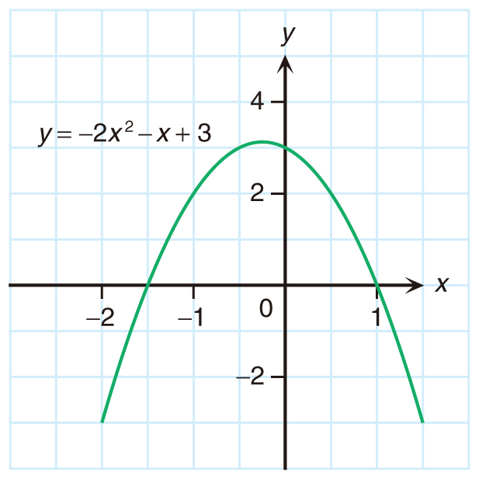
Solve –2x² – x + 3 > 2 graphically.
Step 1
Write down the corresponding simultaneous equations
y = –2x² – x + 3
.
y = 2

Slide 8

Solve –2x² – x + 3 > 2 graphically.
Step 2
The two graphs intersect at x = –1 and x = 0.5.
Draw the horizontal line
y = 2 on the graph of
y = –2x² – x + 3.
y = 2

Slide 9
Solve –2x² – x + 3 > 2 graphically.
So it gives the solutions of the given inequality.
The values of y in this
part are greater than 2.
Step 3
Determine which part(s) of the graph of y = –2x² – x + 3 give(s) the solutions of the given inequality.
y = 2

Slide 10


Solve –2x² – x + 3 > 2 graphically.
Step 4
Write down the range of values of x that satisfy the given inequality.
y = 2
For the range –1 < x < 0.5,
the corresponding part of the graph of y = –2x² – x + 3 lies above the line y = 2.
∴ The solutions of –2x² – x + 3 > 2 are
–1 < x < 0.5.

Slide 11
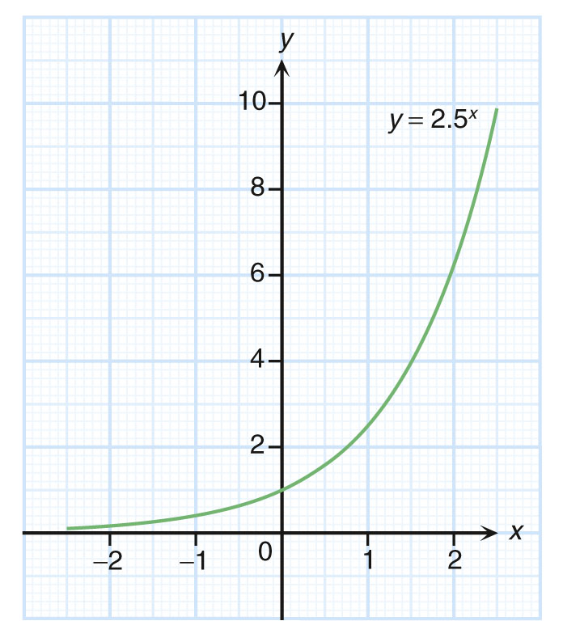
Follow-up question
Given the graph of y = 2.5^{x}, solve
the inequality 2.5^{x} ≥ 4 graphically.
‘ ’ means the point is included.
Draw the horizontal line y = 4 on
the graph of y = 2.5^{x}.
The two graphs intersect at x = 1.5.
y = 4
For the range x ≥ 1.5,
the
corresponding part of the graph of
y = 2.5^{x} lies on or above the line y = 4.
∴ The solutions of 2.5^{x} ≥ 4 are x ≥ 1.5.

Slide 12
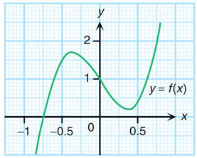


Consider the graph of y = f(x).
Can we solve 2f(x) – 1 < 2
by using the graph of y = f(x)?
Yes, we can rewrite the inequality
into the form f(x) < k first.

Slide 13
Consider the graph of y = f(x).
2 f(x) – 1 < 2
2 f(x) < 3
f(x) < 1.5
Firstly, rewrite it into the form f(x) < k.
y = 1.5
Then, solve
f(x) < 1.5 graphically.
Draw the horizontal line y = 1.5 on the graph of y = f(x).
The two graphs intersect at x = –0.5, x = –0.2 and x = 0.7.
For the ranges x < –0.5 and –0.2 < x < 0.7,
the corresponding parts of the graph of y = f(x) lie below the line y = 1.5.
∴ The solutions of 2 f(x) – 1 < 2 are
x < –0.5 or –0.2 < x < 0.7.

Slide 14
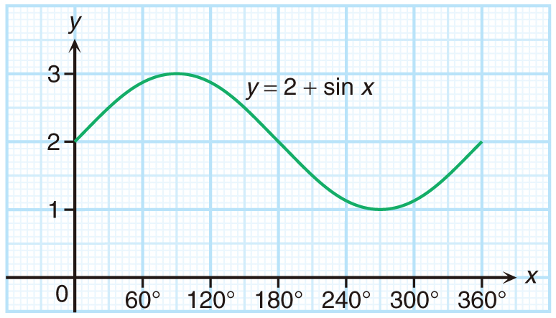
Follow-up question
The figure shows the graph of
y = 2 + sin x for 0° ≤ x ≤ 360°. Solve the inequality 2 sin x ≤ 1 for 0° ≤ x ≤ 360° graphically.
y = 2.5
2 sin x ≤ 1
sin x ≤ 0.5
2 + sin x ≤ 2.5
 Rewrite into the form 2 + sin x ≤ k.
Draw the horizontal line y = 2.5 on the graph of y = 2 + sin x.
The two graphs intersect at x = 30° and x = 150°.
For the ranges 0° ≤ x ≤ 30° and 150° ≤ x ≤ 360°,
the corresponding parts of the graph of y = 2 + sin x lie
on or below the line y = 2.5.
∴ The solutions of 2 sin x ≤ 1 are 0°≤ x ≤ 30° or
150° ≤ x ≤ 360°.

